Slide 1

Vehicle Loan Default Prediction
Team Details
Guided by
Mr. Animesh Tiwari
Abhilash SR
Krishnamurthy S
Krishnaraj Palanychamy
Prabhakaran S
Pravin Kumar S
Vishwanath Kannan

Slide 2

Introduction
L&T Finance, prominent in providing housing loans and infrastructure financing has entered into the vehicle loan market.
The management is interested in assessing the company’s performance in the market.
We belong to the analytics team tasked with predicting the potential customers and defaulters.

Slide 3
Problem Definition
Reduce bad loans by filtering out potential defaulting customers and identify potential non-defaulters so as to offer good LTV for their loan.
We are using ML algorithms to predict whether or not he/she will default in his/her first EMI payment.

Slide 4
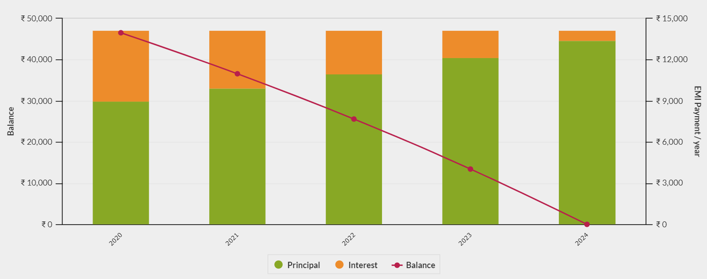
EMI Payment Schedule
Source: emicalculator.net

Slide 5
Data Dictionary
https://www.kaggle.com/mamtadhaker/lt-vehicle-loan-default-prediction
The Dataset contains 233154 Rows and 41 Columns
14 Numerical columns,2 Datetype columns and 25 Categorical columns
The Only column with missing values is Employment Type. It has 7661 missing values which is about 3.3% of the data
Current Balance has 1,50,000 Entries as zero, out of which 70,000 entries have applied for their first loan

Slide 6
Columns
Current Loan
Disbursed Amount
Asset Cost
Loan to Asset ratio(ltv)
Document Submitted
Aadhar Flag
Passport Flag
Driving License Flag
Mobile No Avl. Flag
PAN Flag
Voter ID Flag
Date Information
Disbursal Date
Credit History Length
Average Account Age
Bureau Information
CNS Score
CNS Score Description
Disbursing Bank Information
Branch ID Supplier ID
Manufacture ID Current PINCODE ID
State ID
Employee Code ID
Primary Account Information
Pri. No. of Accounts
Pri. Active Account
Pri. Overdue Account
Pri. Current Balance
Pri. Sanctioned Balance
Pri Disbursed Amount
Pri Installment Amount
Secondary Account Information
Sec. Number of Accounts
Sec. Active Account
Sec. Overdue Account
Sec. Current Balance
Sec. Sanctioned Balance
Sec Disbursed Amount
Sec Installment Amount
Other Customer Information
Date of Birth
New Accounts In Last 6 months
Delinquent Accounts in 6 months
No Of Inquires
Loan Default (Target Variable)

Slide 7
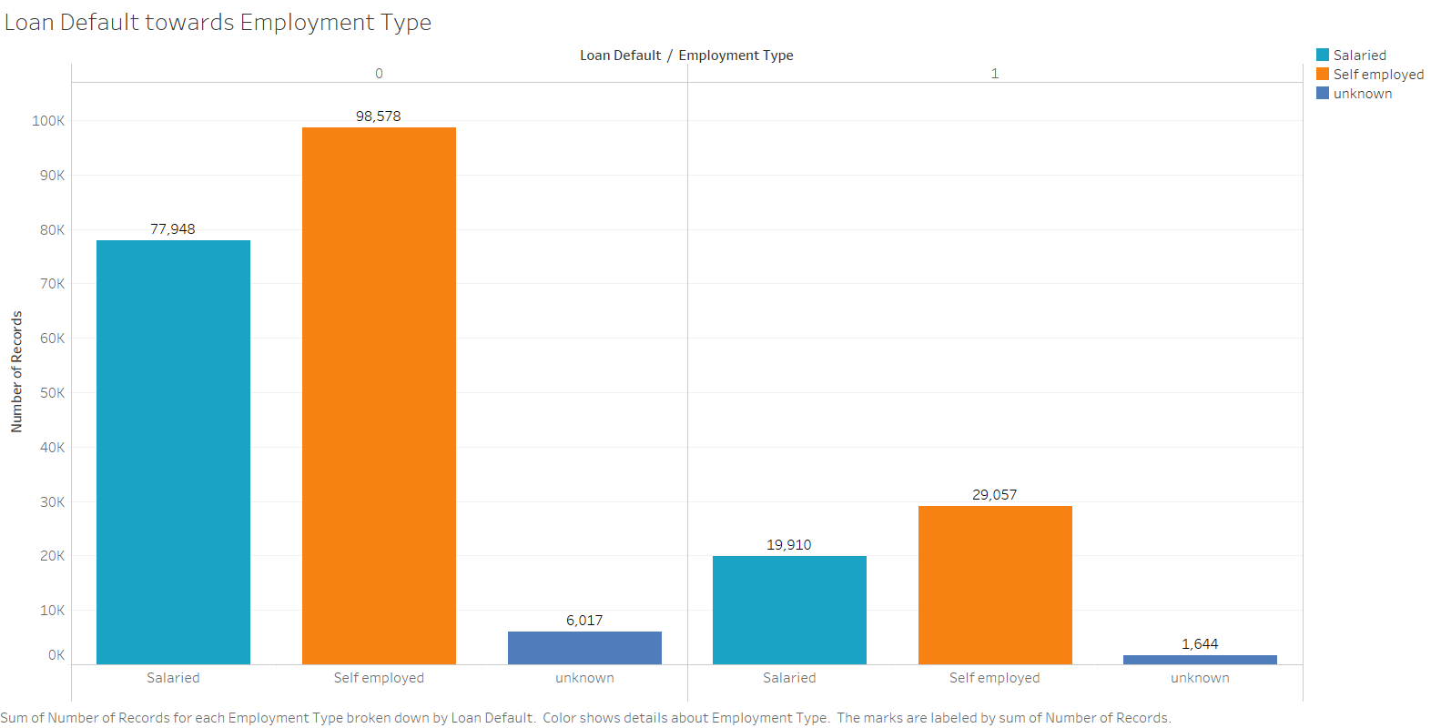
Loan Default from Employment Type
Not Defaulted
Defaulted

Slide 8
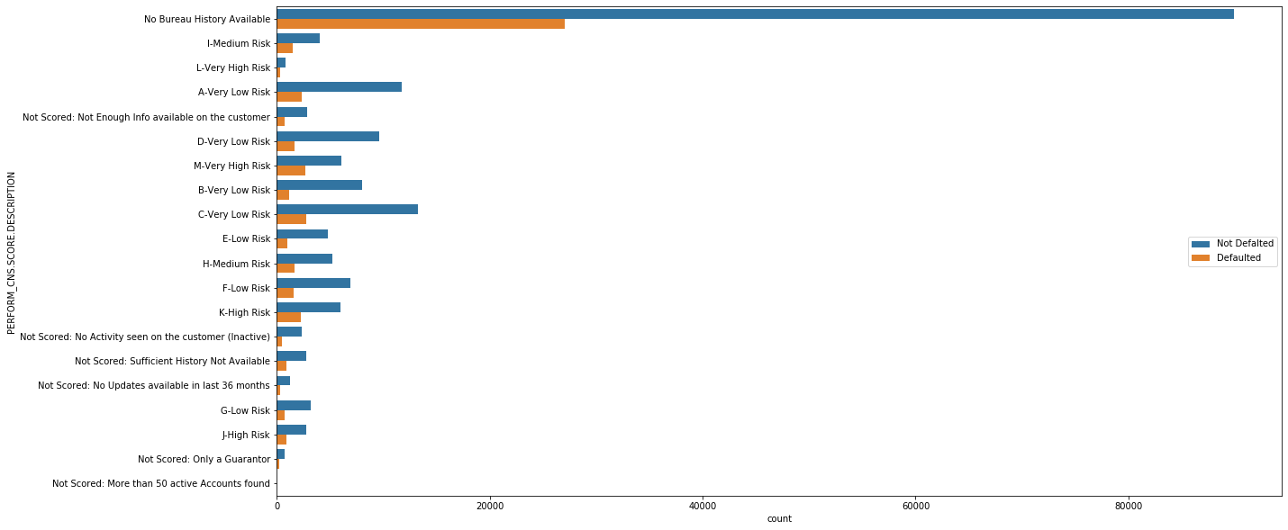
CNS Score Description

Slide 9
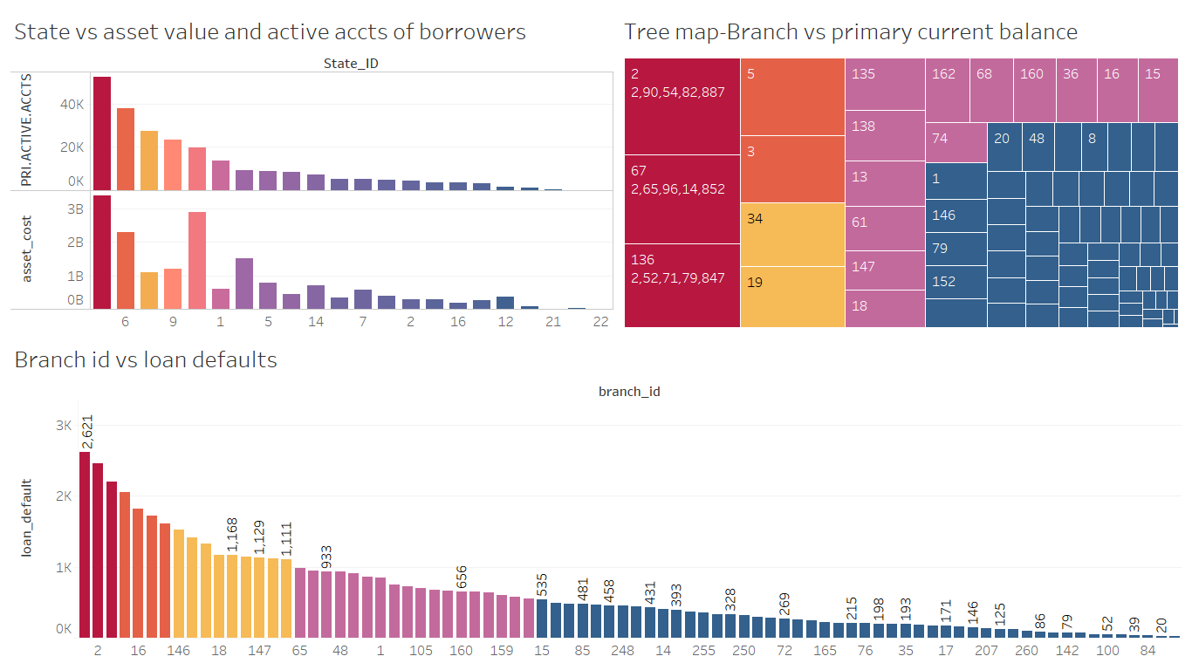
Branch with the Active users

Slide 10
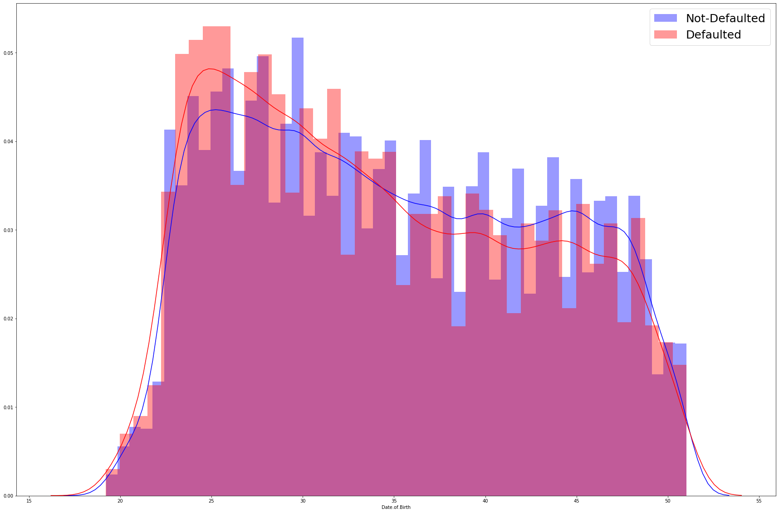
Age Distribution of Defaulters

Slide 11
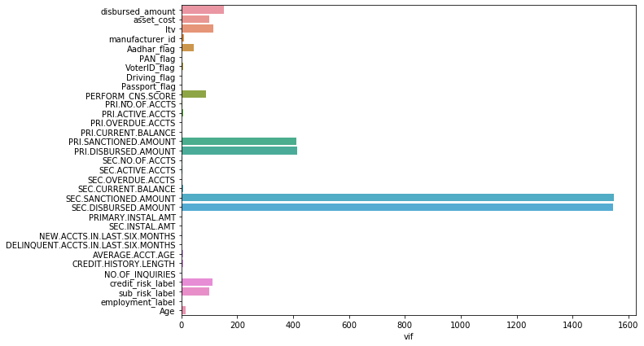
Multicollinearity

Slide 12
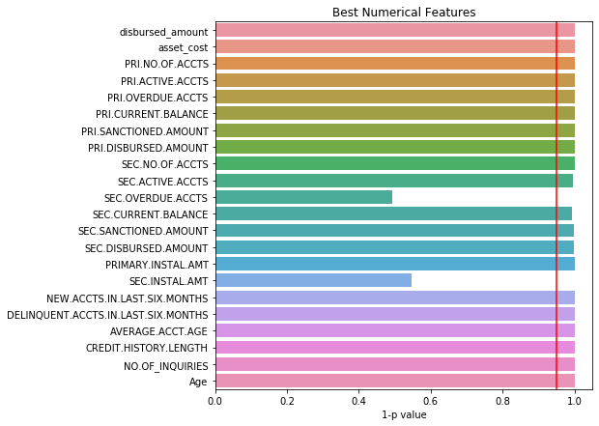
Statistical significance of Numerical variables
(1-p value)

Slide 13
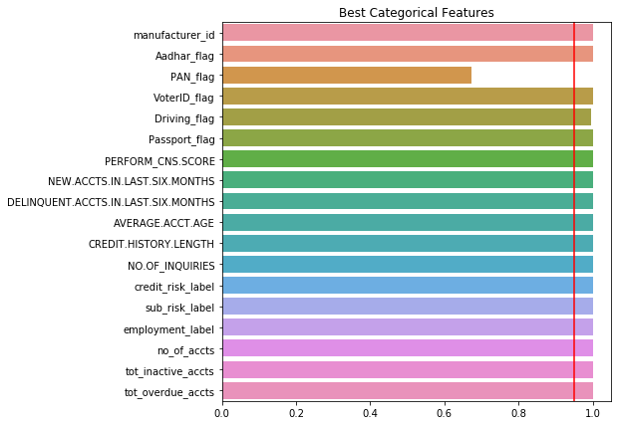
Statistical significance of Categorical variables
(1-p value)

Slide 14
Model Building
1. Transformations :
Yes . Since the data is not normally distributed (Highly right skewed), We tried Log transform, Sqrt transform.
2. Scaling the data :
Yes, the data has been scaled. Also used Robust Scaler.
3. Data Imbalance
Target column is showing 78:22 ratio distribution. So we ran iterations with Undersampling and SMOTE.
4. Dimensionality reduction :
Since there is no multicollinearity in our data presently(removed after checking VIF), We haven’t done PCA since resulted Principal Components was very low.
5. Added New Column to Describe Not Applicable Features of each Customer.

Slide 15
Model Performances
Model | Train | Test | Precision | Recall | F1
Logistic | 0.621 | 0.623 | 0.304 | 0.57 | 0.397
Decision Tree (Entropy) | 1 | 0.979 | 0.94 | 0.95 | 0.9522
Decision Tree(Gini) | 1 | 0.979 | 0.945 | 0.958 | 0.952
Random Forest | 1 | 0.953 | 0.953 | 0.827 | 0.885
Naïve Bayes | 0.577 | 0.583 | 0.263 | 0.512 | 0.348
Bagging Classifier | 0.999 | 0.981 | 0.964 | 0.949 | 0.9566
Adaboost | 0.885 | 0.859 | 0.636 | 0.821 | 0.717
XGBoost | 0.962 | 0.955 | 0.927 | 0.862 | 0.893

Slide 16
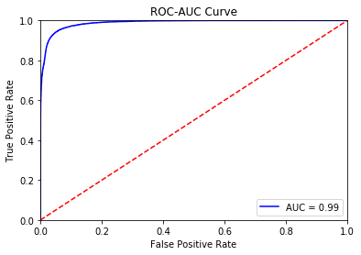
XGBoost Model Performance
Confusion Matrix
ROC-AUC Curve
 | Actual Defaulters | Actual Non-Defaulters
Predicted Defaulters | 13096 | 1027
Predicted Non-Defaulters | 2095 | 53729

Slide 17
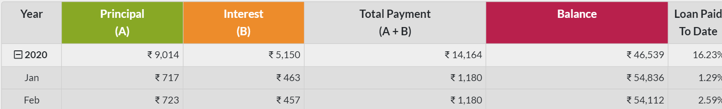
Profit Generated from Loans
Median Sanctioned Amount -> Rs. 55553
Rs. 1180
Monthly EMI Amount
Principal Part of EMI
Interest Part of EMI, which is the L&T’s Income
Rs. 717
Rs. 463

Slide 18



Return on Investment
 | Actual Defaulters | Actual Non-Defaulters
Predicted Defaulters | 13096 | 1027
Predicted Non-Defaulters | 2095 | 53729
Actual
Potential Customers that are excluded by our model.
L&T’s income from one borrower : Rs 463
Without model -> 2,53,52,028(Income)
- 70,33,433(Loss)
Net Income = 1,83,18,595
Non-Potential Customers that are given loan by our model.
With our model -> 2,48,76,527(Income)
- 9,69,985 (Loss)
- 4,75,501 (Loss)
Net Income = 2,34,31,041
50,00,000 more income
% income increased = 0.167

Slide 19
Business Suggestions
Age group of 25-30 seems to be most vulnerable to defaulting their EMIs so we can rectify this trend by providing them with low interest loans over a longer period of time. Reducing the LTV ratio for these loans also reduces the risk behind these loans.
We can observe that there are few branches performing significantly worse so providing branch specific solutions would prove provident.
Few potential columns needed :
Interest Rate
Loan period
New Vehicle
Age of Vehicle

Slide 20
Thank You!

